Slide 1

Objectivity in Practice:
Disenchanting AI
EENPS 2022, Tartu, August 17, 2022
DALL-E generated image: “AI wondering if it is a tool”
Live from New York…
Mark Theunissen (Delft Technical University)
Jacob Browning (New York University)

Slide 2
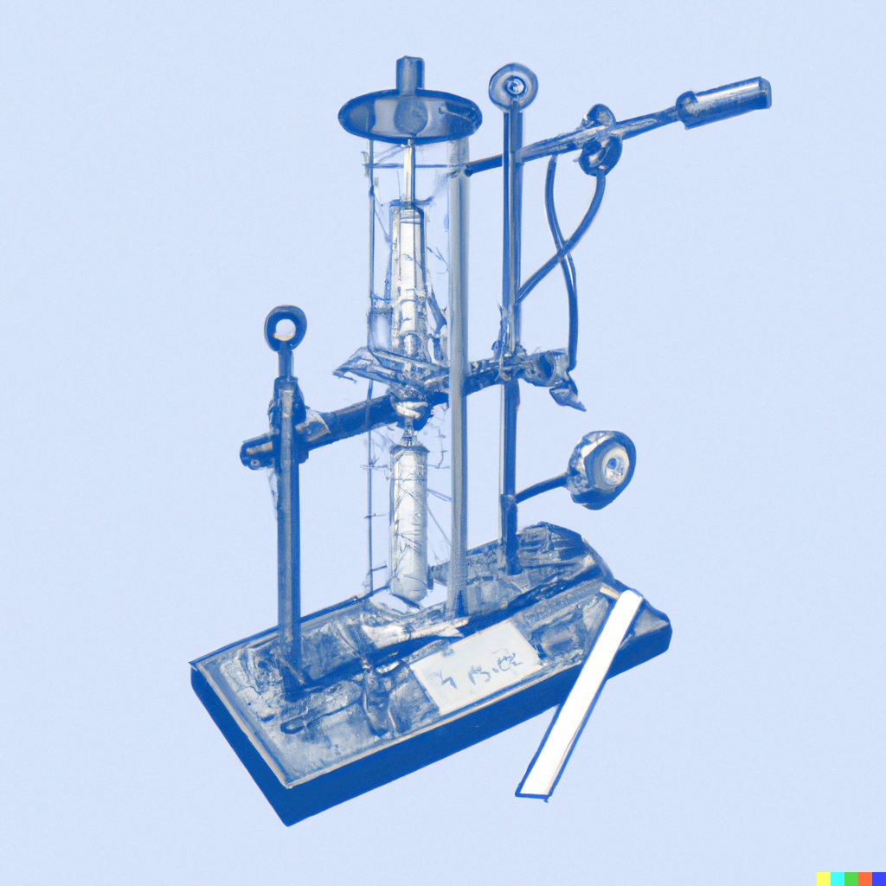
Mechanical Objectivity
“19th Century Scientific Measuring Device hand drawn sketch” - DALL·E 2022-08-15

Slide 4
Outline
Epistemic Challenges of AI
Risk Account of Scientific Objectivity
The Dilemma
AI as an Epistemic Agent
Conclusion: Interpretation on a Spectrum

Slide 5
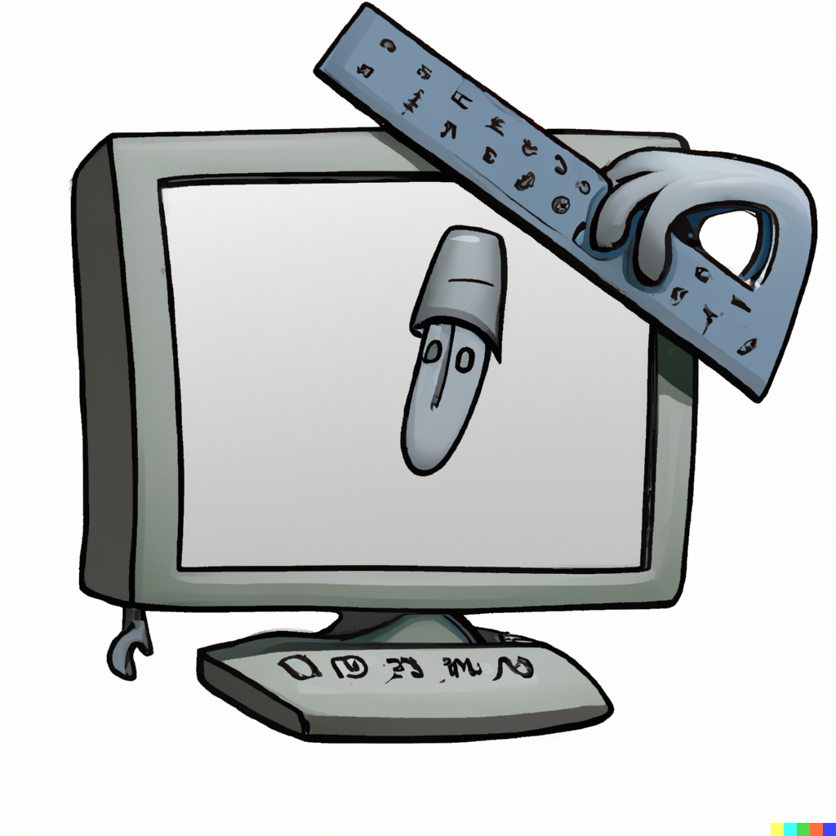
1. The Epistemic Challenges of ML
An AI measuring itself? “A computer measuring a gadget” - DALL-E generated image
Notes:
AI can’t measure itself…

Slide 6
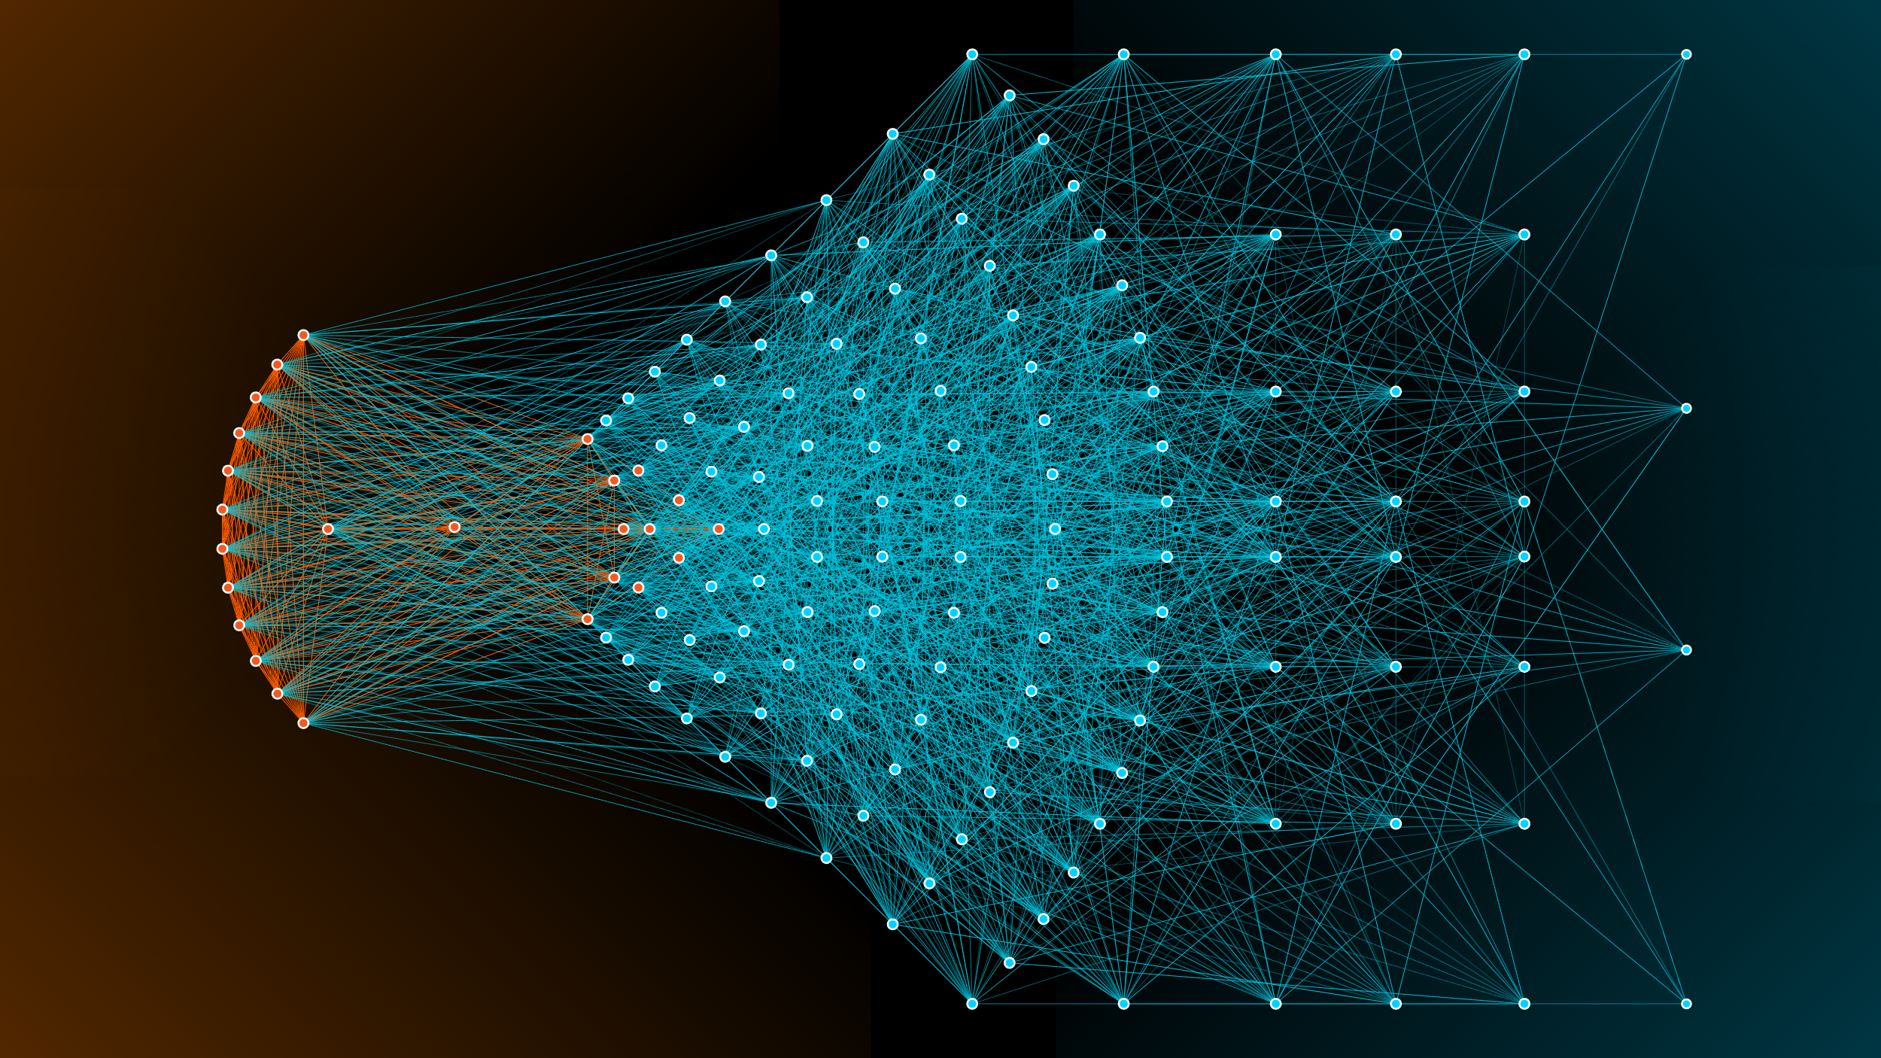
Epistemic Opacity
Image invoking ‘complexity’ and ‘opaqueness’

Slide 7
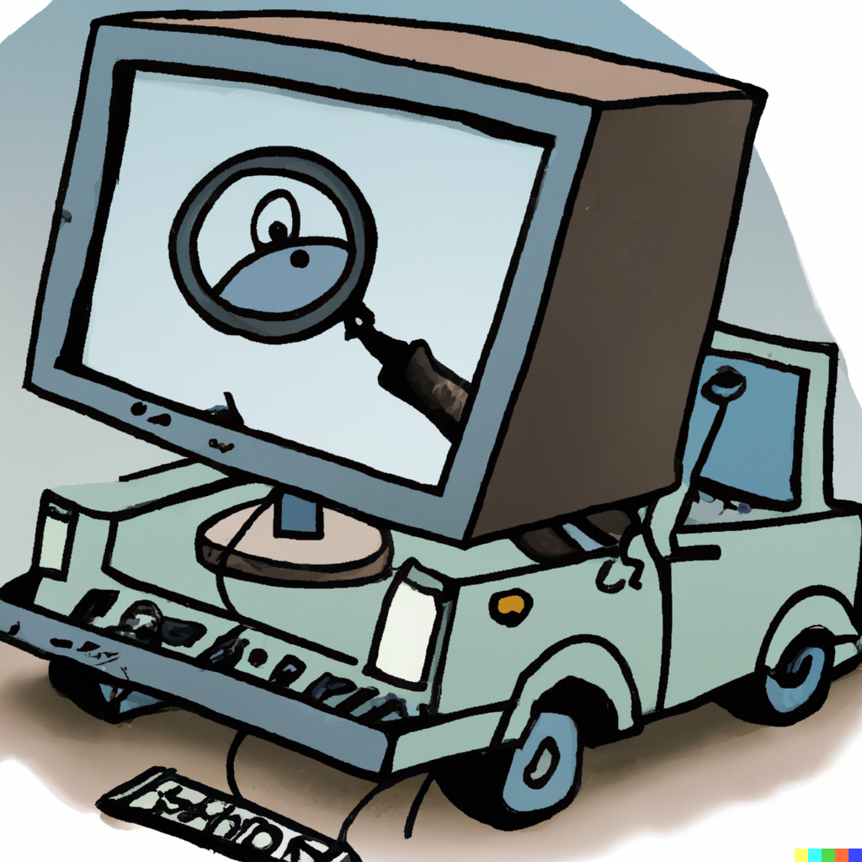
Epistemic Opacity
“A computer trying to find its own blind spots cartoon” - DALL·E 2022-08-15

Slide 8
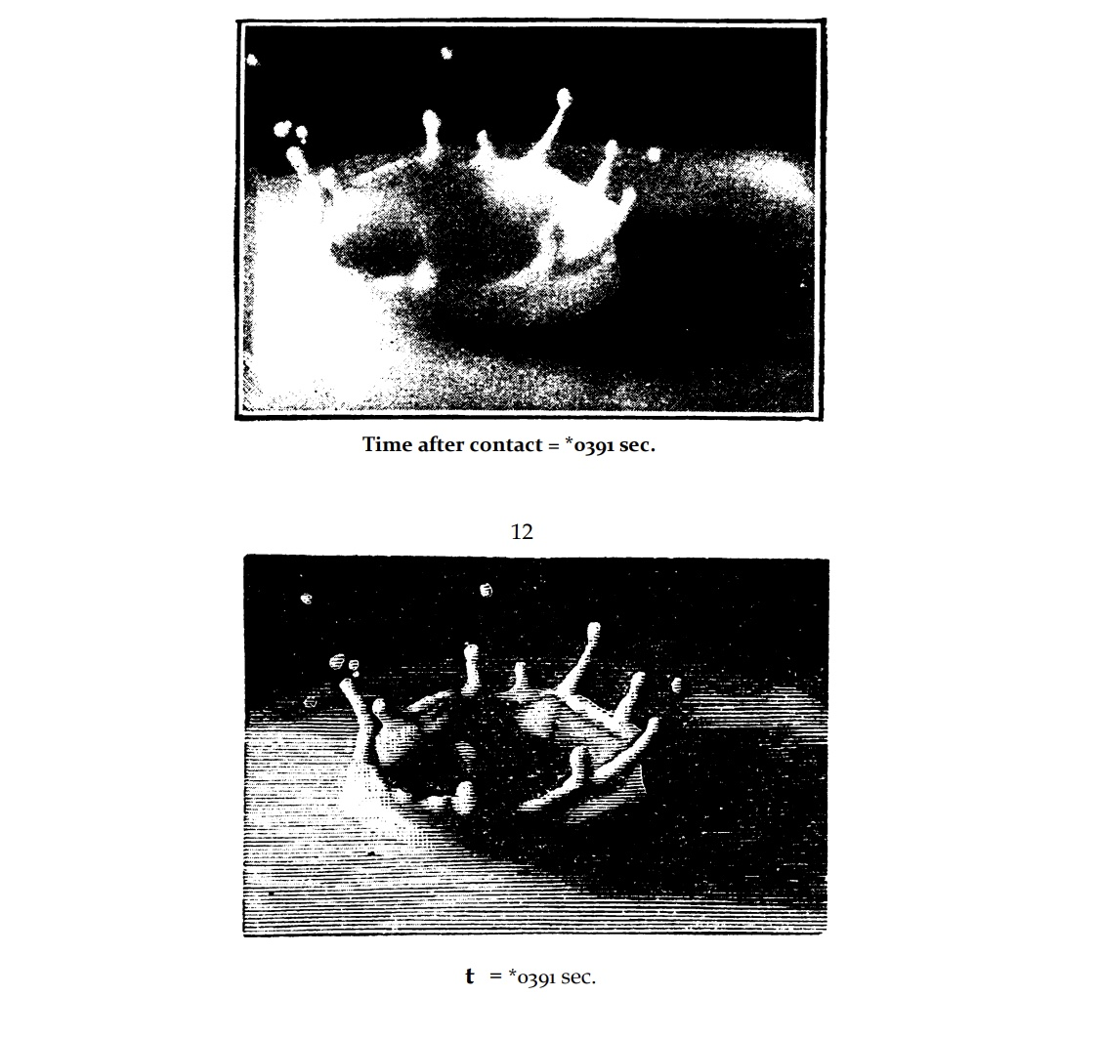
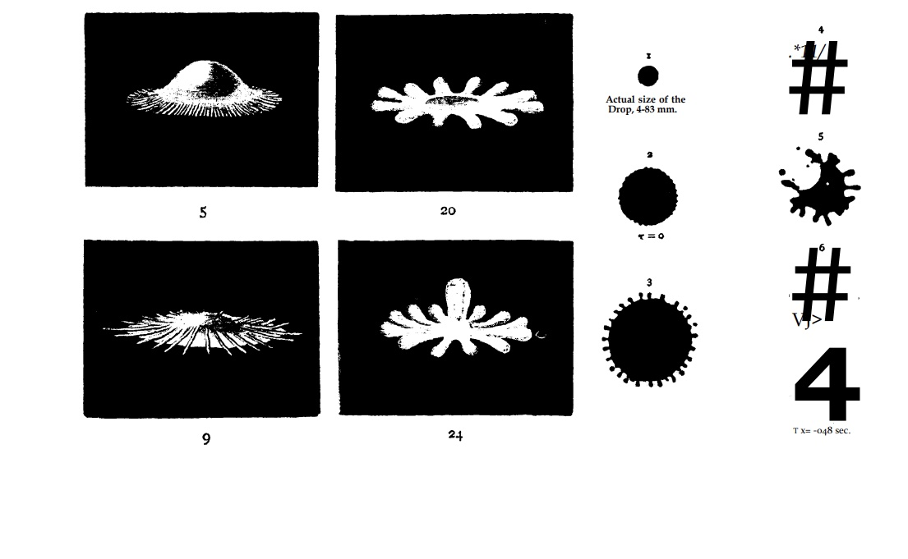
2. The Risk Account of Objectivity
History of Objectivity: Left hand-drawn droplets from visual inspection, Right photographed droplets using strob0scope. (From Objectivity Daston and Gallison.)
Notes:
CROP

Slide 9
Inkeri Koskinen:
I argue that when we call X objective, we endorse it: we say that we rely on X, and that others should do so too. But the word ‘objective’ is reserved for a specific type of reliance: it is based on the belief that important epistemic risks arising from our imperfections as epistemic agents have been effectively averted. (2018: 1188)

Slide 10
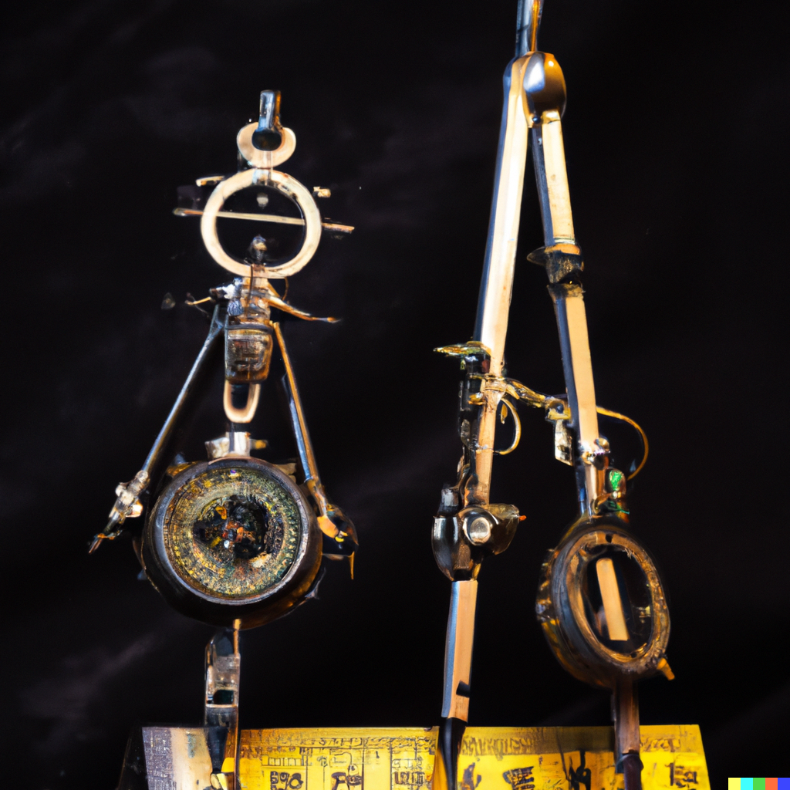
Tools and Technology
“A steampunk ruler and compass” - DALL·E 2022-08-16
Notes:
Risk Averse Tool Cartoon / Thermometer
Steam Punk Machine

Slide 11

3. The Dilemma
When MLs replacing tacit knowledge based skills and judgments made by humans should we think of these systems as Agents or as Tools?
“A tool transforming into a human, cartoon” - DALL·E 2022-08-16
Notes:
Agents or Tools?
Agents or Tool
A lot of AI is not terminatory

Slide 12
The Dilemma
In Koskinen’s words:
As AI systems are used increasingly in science, and as the ways in which AI works are not transparent to humans, an AI system may gain the role of an epistemic agent in scientific research. Algorithmic AI systems, or any other AI systems, do not constitute perfect epistemic agents: it is not always possible to detect why a particular trained model is effective in completing its task, and such a model may also fail in unpredictable ways. …. This may bring about new, unforeseen ways of being imperfect as an epistemic agent—and, as a result, new epistemic risks. It remains to be seen whether the notion of objectivity will be applied to such cases, or whether we continue focusing on individual and collective human agents. This does not in any substantial sense threaten the risk account, but it may either bring about new senses of objectivity, or require a small alteration in the account. Either we accept AI systems as agents that may be sources of bias, and begin assessing their objectivity, or the account should be changed so that it only covers the imperfections of human agents.

Slide 13

Images Recognition: Tool or Agent?
AI Tool that can help detect Melanoma

Slide 14
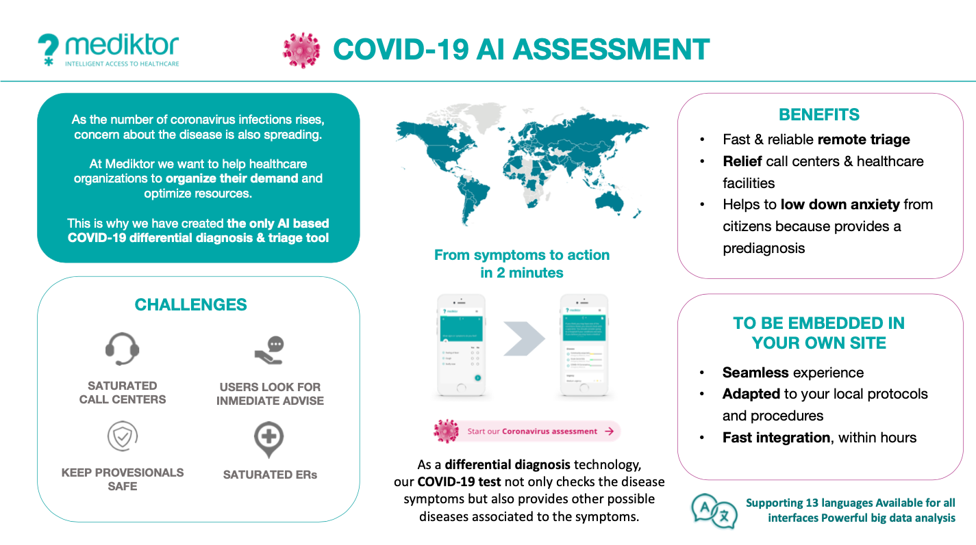
Link Uncertainty: Diagnostic Tools
COVID Assessment Tool
Notes:
CHANGE

Slide 15
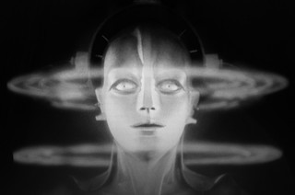
4/ AI as an Epistemic agent
‘Fake-Maria’ – Metropolis, Fritz Lang

Slide 16


Interpreting Artificial Epistemic Agents as Alien Others
Classics from anthropological on interpreting ’alien others’: Frazer’s ‘Golden Bough’ and Evans-Pritchard’s ‘Witchcraft, Oracles and Magic Among the Azande’

Slide 17
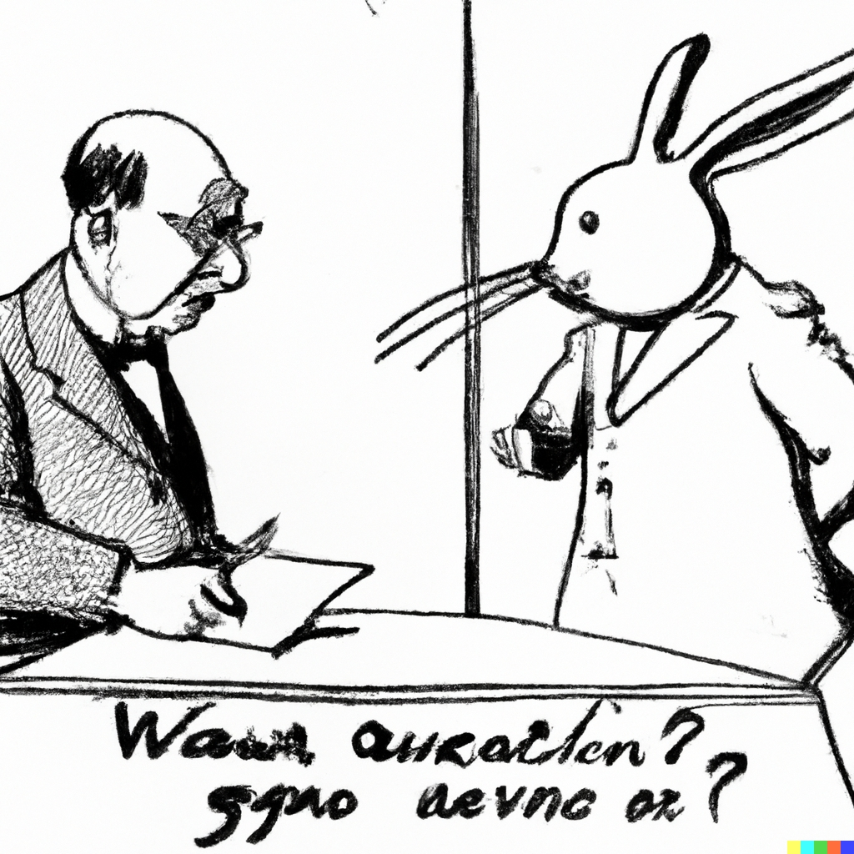
Explanatory Coherence
Choose that interpretation that has the highest explanatory coherence.
“Image of Quine guessing what part of a rabbit ‘gavagai’ refers to” – DALL-E

Slide 18
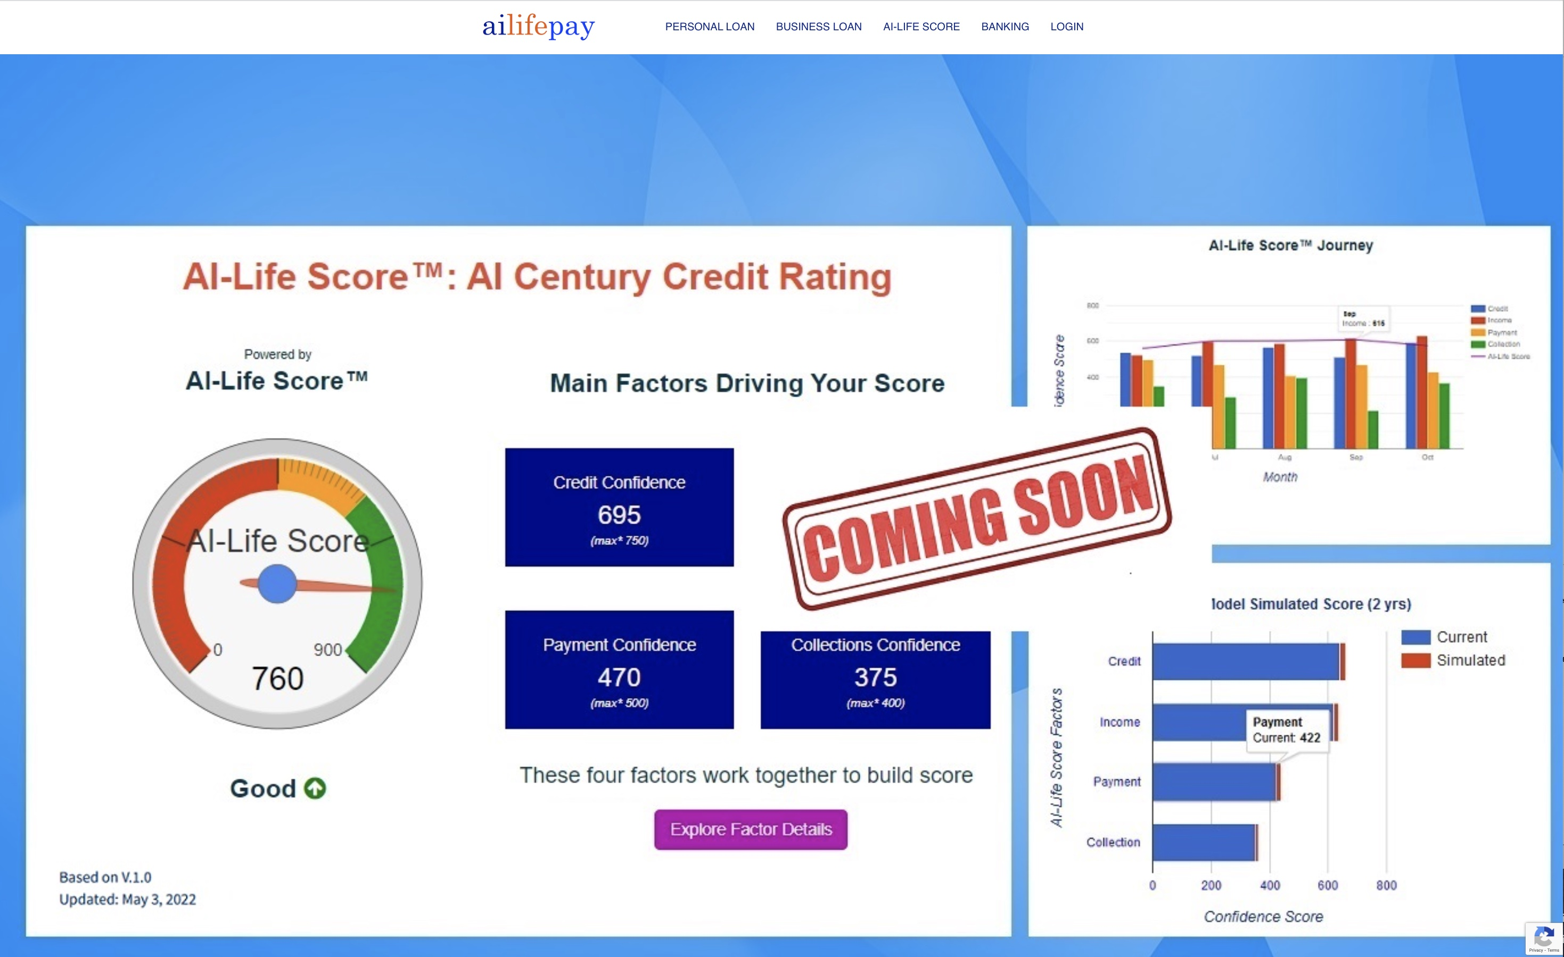
Loan Payment System
AI Credit Rating Tool – ‘AI life pay’- https://ailifepay.com/

Slide 19
Objective AI on a spectrum
Risk-Aversity
Screening
Epistemic Agency
Interpretative Range
Workplace
Credit Rating
Notes:
Tube little think there

Slide 20
Thank you
Mark Theunissen - M.R.Theunissen@tudelft.nl
Jacob Browning - jb7286@nyu.edu

Slide 21
Selected Sources
Durán, J. M. (2021). Dissecting scientific explanation in AI (sXAI): A case for medicine and healthcare. Artificial Intelligence, 297, 1034-98.
Gaube, S., Suresh, H., Raue, M., Merritt, A., Berkowitz, S. J., Lermer, E., ... & Ghassemi, M. (2021). Do as AI say: susceptibility in deployment of clinical decision-aids. NPJ digital medicine, 4(31), 1-8.
Koskinen, I. (2020). Defending a risk account of scientific objectivity. The British Journal for the Philosophy of Science, 71(4), 1187-1207.
Sullivan, E. (2019). Understanding from Machine Learning Models, The British Journal for the Philosophy of Science. E-pub ahead of print.
Theunissen, M., Browning, (2022) J. Putting explainable AI in context: institutional explanations for medical AI. Ethics Inf Technol 24, 23
Zednik, C. (2021) Solving the Black Box Problem: A Normative Framework for Explainable Artificial Intelligence. Philosophy and Technology, 34, 265-288.

Slide 22
Interviewer.ai

Slide 23
“We define explainability as the ability for the human user to understand the agent’s logic” (Rosenfeld and Richardson, 2019)
“an explanation is an ”interface” between humans and a decision maker that is both an accurate proxy of the decision maker and comprehensible to humans” (Guidotti et al, 2018)
“An explanation is additional meta information generated … to describe the feature importance or relevance of an input instance towards a particular output classification” (Das and Rad, 2020)
Definitions of Explainability

Slide 24
Why XAI? Robbins
Against a blanket requirement of explainability on AI models:
What requires explanations are decisions/actions, not processes. And we only care about explanations when the consequences of those actions significantly affect someone
For example: do we need explanations for an ML algorithm that performs highly accurate quality control in a factory? (as compared to e.g. an algorithm making hiring decisions)
When low risk we should thus, Robbins argues, adopt opaque AI of sufficient accuracy. No explanations necessary

